Slide 1
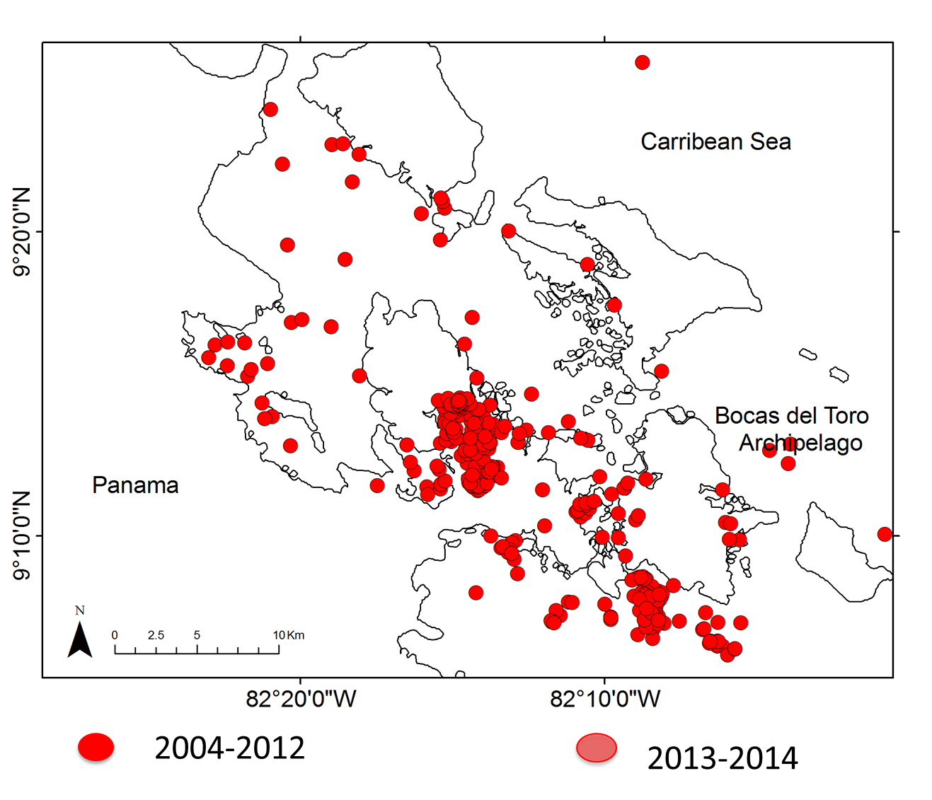
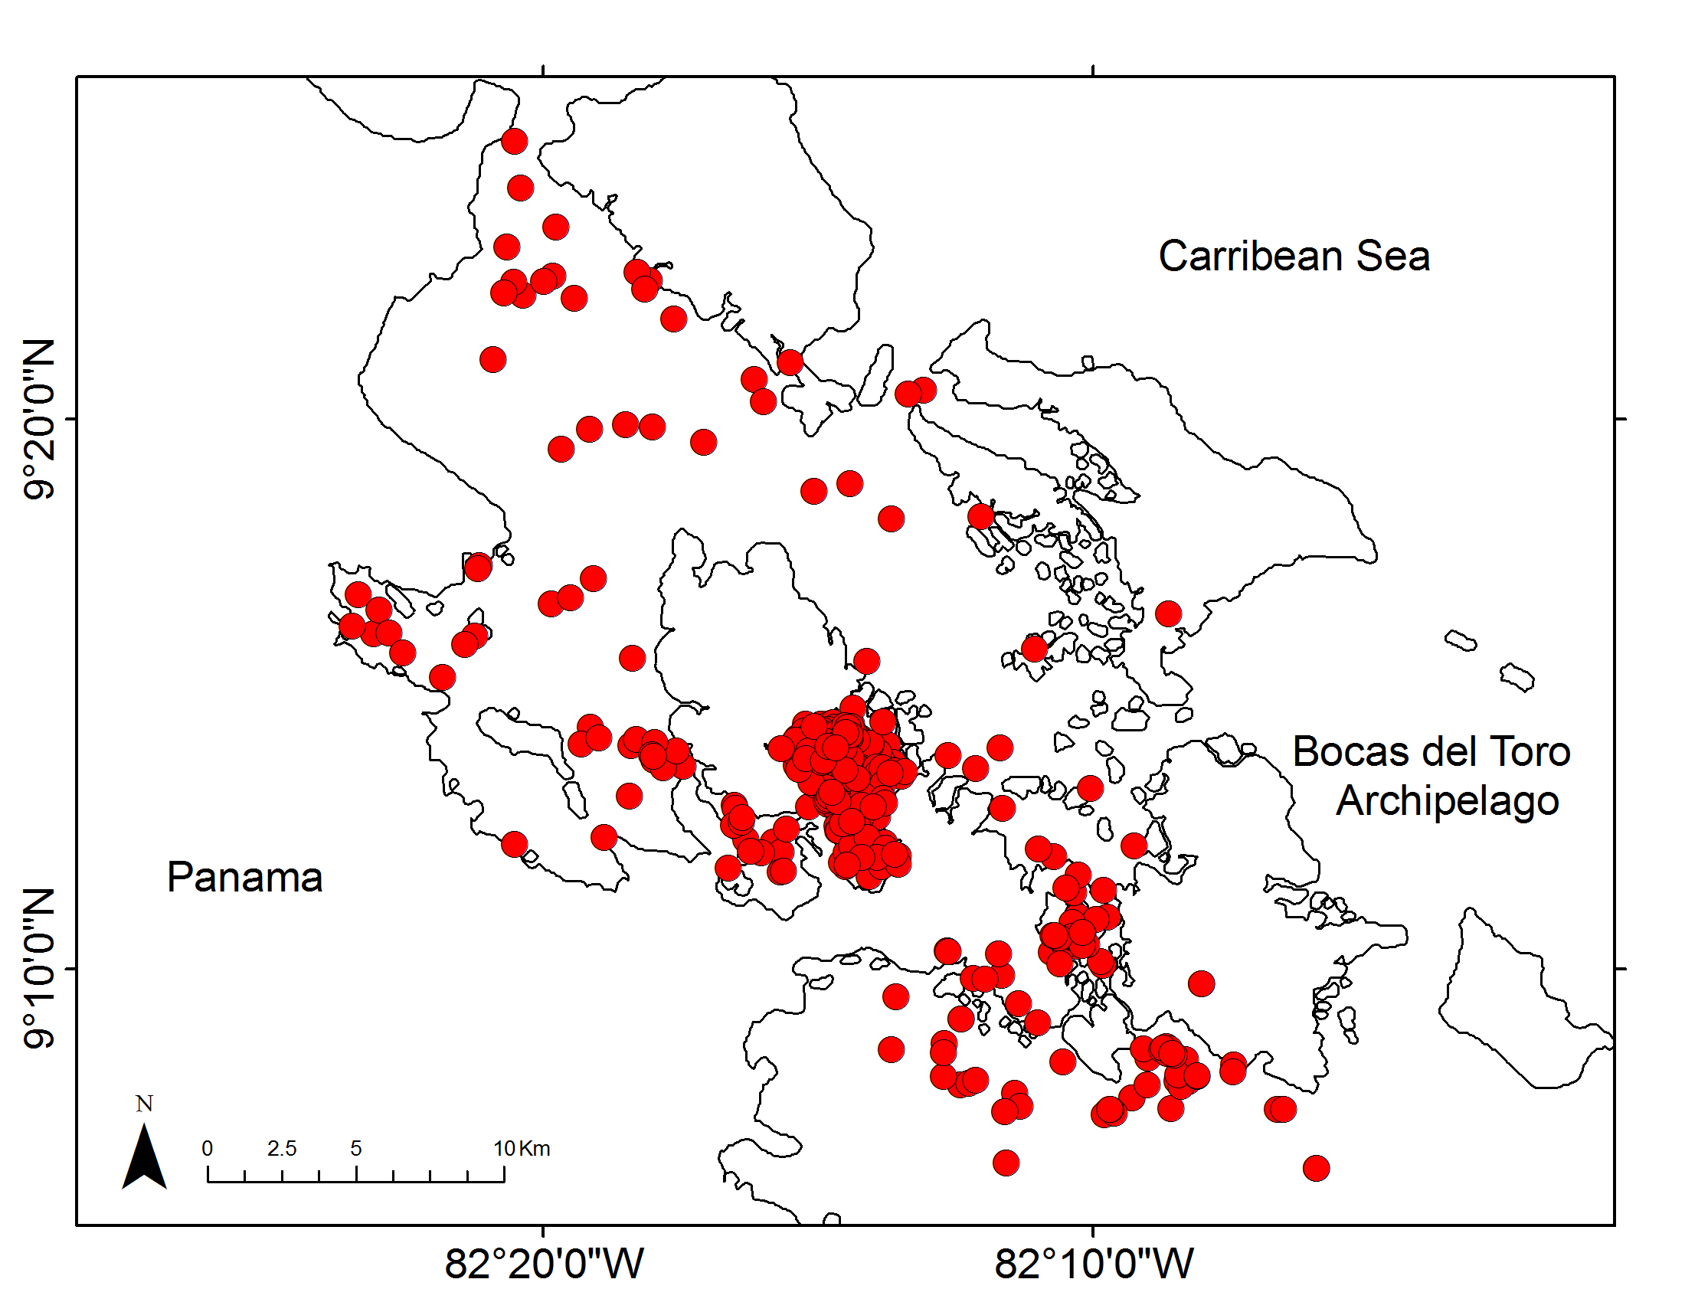
The effect of changing ambient noise levels on the whistle acoustic structure of dolphins in Bocas del Toro, Panama.
Laura J. May-Collado¹ and Douglas Wartzok²
¹Biology Department, University of Vermont, VT, USA
²Department of Biological Sciences, Florida International University, FL, USA
The resident population of bottlenose dolphins in Bocas del Toro sustains the largest dolphin watching industry in Panama. Our previous work has shown that these dolphins respond to boat presence by increasing whistle duration and lowering their minimum frequency. The usual assumption is that the noise associated with dolphin-watching boats is responsible for the change in whistle parameters. Here we evaluate the effect of noise levels on whistles acoustic structure by measuring ambient noise levels and whistle standard parameters from multiple years and under various boat interactions. Overall, noise levels were higher as the number of dolphin watching boats increased, however, there is significant variation in dolphin whistle parameters across years. Our results indicate that ending frequency was significantly lower in the presence of more than six boats and that 8% of the variation in whistles minimum frequency is explained by the interaction between noise level and year. In contrast variations in ending frequency, peak frequency, and duration show significant variation by year alone. These results indicate that while annual variations in noise levels can significantly affect dolphin communication, noise per se is less important than other cues and other sensory modalities associated with these boat-dolphin interactions
Introduction
Results
May-Collado and colleagues have monitored interactions between dolphins and the dolphin watching industry for the past 10 years in Bocas del Toro, Panama¹⁻².
Our previous work showed that dolphins significantly respond to boat presence by increasing whistle duration and lowering their minimum frequency, particularly when engaged in foraging activities^{3,4}.
Noise increased with the number of boats as shown in Fig. 4 (χ²=9.68, df=2, p=0.0079). However for dolphin whistles, only ending frequency was significantly lower (χ²=14.4, df=2, p=0.0008) in the presence of more than 6 boats. After adjusting the level of significance for multiple comparisons to α=0.006, our results indicate that 8% of the variation in whistles minimum frequency is explained by the interaction between noise levels and year (F=5.52, df=2, p=0.005). In contrast, 16%, 22%, and 11% of the variation in whistle ending frequency (F=7.81, df=2, p=0.0006), peak frequency (F=17.3, df=2, p<0.0001), and duration (F=4.28, df=5, p=0.001) was explained by year, respectively.
Bocas del Toro
Research
Boat
Transport
Boat
Research
Boat
DW
Boat
Research
Boat
Transport
Boat
Research
Boat
DW
Boat
Figure 1. Distribution of dolphin groups sighted during boat-surveys using pre-determined transects (2004-2012) and non-systematic surveys (2013-2014). The circled area is where dolphin watching activities concentrate.
Low
High
Low
High
Noise dBrms
Figure 3. Bocas dolphins emit whistles that vary in duration and minimum frequency between areas with low and high boat traffic and with type of boat interaction.
We have observed a rapid and disorganized growth of the dolphin watching industry resulting in an annual increase in the number of boats interacting with the same group of dolphins within a period of 1h from 2 to 39 boats.
The assumption is that noise associated with dolphin watching boats is responsible for this change in dolphin whistle parameters. In this study we evaluate the effect of noise levels on whistles acoustic structure by analyzing recordings obtained in 2007, 2008 and 2012 under various boat interactions.
0 to 1
2 to 5
6+
Number of Boats
Methods
Figure 4. Noise dBrms mean values increase with number of boats.
Recordings were made using a Reson 4033 hydrophone (sensitivity -203 dB ± 2 dB 1Hz to 80 kHz) connected through a charge amplifier to Avisoft UltraSoundGate 116Hb data acquisition hardware with adjustable, discrete gain settings. The digital output was stored on a laptop computer. We used the PAMGuide.R package⁵ to measure ambient noise levels (RMS values, 100Hz to 48kHz) for each of these recordings. Recordings for analysis were chosen from those not dominated by snapping shrimp. For each whistle within those recordings we measured standard variables: minimum, maximum, start, end, peak, delta frequencies (kHz) and duration (s).
Conclusions
These results indicate that while noise increases with number of boats, noise per se only explained a small percent of the variation observed in dolphin whistle structure. This suggest that other aspects of dolphin watching boats could be affecting dolphin whistles. The dolphins are likely using vision as well as hearing to integrate factors such as mode of approach, increase in quantity of boats, and noise generated by the boats.
Figure 2. Number of dolphin watching boats interacting simultaneously with the same group of dolphins within 1 hour period
References
May-Collado, L. J.1,2, Barragán-Barrera, D. C.3, Quiñones-Lebrón, S. G.1, & W. Aquino-Reynoso1. 2012. Dolphin watching boats impact on habitat use and communication of bottlenose dolphins in Bocas delToro, Panama during 2004, 2006-2010. International Whaling Commission. SC/64/WW2.
May-Collado, L. J., Quiñones-Lebrón, S. G., Barragán-Barrera, D. C., Jose D. Palacios, Monica Gamboa-Poveda. 2014. The dolphin watching industry of Bocas del Toro continues impacting the resident bottlenose dolphin population. International Whaling Commission, Slovenia. SC/65b/WW06.
May-Collado, L. J. and D. Wartzok. 2008. A comparison of bottlenose dolphin whistle in the Western Atlantic Ocean: insights on factors promoting whistle variation. Journal of Mammalogy. 89:205-216.
May-Collado, L.J. and S. Quinones-Lebron. 2014. Dolphin changes in whistle structure with watercraft activity depends on their behavioral state. J. Acoust. Soc. Am. EL 135, EL193-198.
Merchant, N. D., Fristrup, K. M., Johnson, M. P., Tyack, P. L., Witt, M. J., Blondel, P., Parks, S. E. (2015). Measuring acoustic habitats. Methods in Ecology and Evolution. doi: 10.1111/2041-210X.12330

