Slide 1
How to make a short Scientific Podcast
Alex Taylor

Slide 2
Why a podcast?
Podcasts are streamed by millions of people, and are increasing in popularity
It’s an easy way to talk to lots of people.
They’re a great way to share science
They’re easy to make!
In this presentation I’ll describe how to make a short 3-5 minute podcast

Slide 3
First Piece of Advice
START EARLY.
The earlier you select a topic, write, record, and edit your podcast, the more time you’ll have to refine and perfect your work.
Here’s a suggested schedule:
Monday | Tuesday | Wednesday | Thursday | Friday | Saturday
Choose your topic & write outline | Write your script and read it aloud | Read your script aloud again and rewrite. | Record your script and import into your editor | Edit your script into your episode. Listen to it, record again if needed. | Get creative! Add music, sound effects, etc.

Slide 4
(1) Select a Theme & Find Sources
Look at the topics we’ve covered throughout the semester
Choose something that is interesting to you
In my example, I wanted to learn more about the Whale Pump
Do some research and find some papers, articles, or videos
I found:
https://www.sciencedaily.com/releases/2010/10/101012101255.htm
https://journals.plos.org/plosone/article?id=10.1371/journal.pone.0013255
https://www.nationalgeographic.com/science/phenomena/2015/03/17/sciencespeak-whale-pump/
https://www.esa.org/esablog/research/poo-pump-whales-as-ecosystem-engineers/
http://dx.doi.org/10.1890/130220

Slide 5
(2) Structure your Script and make an Outline
One way to structure your podcast is a simple story structure with:
(A) Exposition: describe the setting / background of your story
(B) Inciting Incident: what questions or ideas came about to the discovery of your topic?
(C) Complication: what got in the way of learning more? How did scientists overcome those hurdles?
(D) Climax: what did scientists find out? What did they learn?
(E) Resolution: How does the topic change the way we think about an animal, an ecosystem, the ocean, etc?

Slide 6
Here’s a diagram that shows this structure visually:

Slide 7
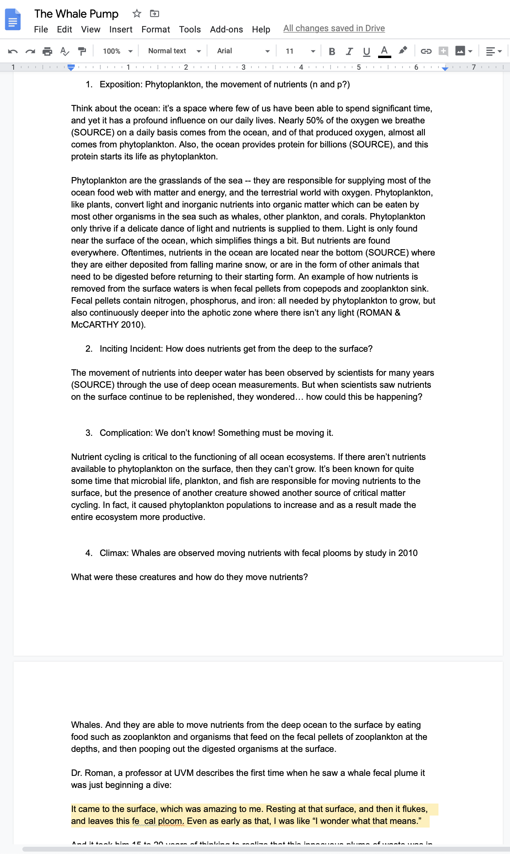
Length
A 3-5 minute podcast will be between 1-1.5 pages single spaced

Slide 8
(3) Edit your script, read it aloud, and see where you can add remove or things.
If you can cut extra information, cut it.
If you can add a line or two to explain a complicated concept, add it.
See where you get tripped up while reading aloud and restructure the wording
See what parts of the story can be told quickly, and what other parts need to be slowed down to get your point across
Print out your script and use a highlighter to point our places you want to slow down with.

Slide 9
(4) Record
If using an iPhone or Android phone, use the Voice Memos app or a voice recording app. Hold the phone about 6” from your mouth when you record.
If you’re using a computer, use a recording app in your computer.
Here’s a comprehensive list: https://support.lesley.edu/support/solutions/articles/4000034124-how-to-record-audio-on-your-computer-or-phone
Record your script multiple times, play around with pacing and phrasing.

Slide 10
(5) Edit
Once you’ve recorded, you’ll have a bunch of audio files that need to be sliced together. You can also add music, sound effects, etc at this point to get creative with your storytelling.
You can use any number of editors for your podcast.
I suggest Audacity: audacityteam.org (it’s free & works on Windows and Mac).
Here’s a great tutorial to get started: https://www.youtube.com/watch?v=GHe_Og-yEow

Slide 11
(6) Getting Creative
All music and sounds in your podcast needs to be licensed. Luckily a lot of open-license audio is free:
Add music
A lot of creators on Soundcloud.com allow you to use their music (check out the use)
Free Music Archive has open use music: https://freemusicarchive.org/static
Jamendo does the same: https://www.jamendo.com/start
Add sound effects
https://freesound.org
More here: https://designmodo.com/free-music-sounds/
Add empty space to pause the storytelling if you want someone to be able to

Slide 12
(7) Listen and relisten to your podcast.
Have your friends listen to it as well
Sleep on it
Listen to it again
Made edits, re-record if you need to
Your segment does not need to be perfect – podcasting is an art and requires lots of practice! But you should try as much as you can to make a great piece.

Slide 13
Sample Podcast
I made a sample podcast about the Whale Pump: https://www.dropbox.com/s/ppr91pk7vx81e0q/Extremely%20Short%20Version.mp3?dl=0
This is by no means a perfect podcast, but it shows some of the ways you can structure a scientific podcast

